Slide 1
Biochem 3BP3 DNA Sequencing & Genome Assembly
First genome - Bacteriophage MS2 in 1976 (3.5 Kbp)
First bacterial genome - Haemophilus influenzae in 1995 (1.8 Mbp)
First eukaryote genome - Saccharomyces cerevisiae in 1996 (12.1 Mbp)
First animal genome - Caenorhabditis elegans in 1998 (100 Mbp)
First plant genome - Arabidopsis thaliana in 2000 (119 Mbp)
Human genome in 2001 (3.2 billion bp)

Slide 2
Genome Sequences as References
A wide variety of research currently uses DNA sequencing as a diagnostic tool or assay, e.g.
RNA-Seq to measure changes in gene expression
ChIP-Seq to understand regulatory binding sites
MolEpi to track movement of pathogens
Exome sequencing to determine genetic underpinnings of disease
These techniques generate tens of millions of DNA sequencing ‘reads’ and these are analyzed by mapping reads to reference genome sequences using “short-read alignment” methods
e.g. Burrows-Wheeler Aligner (BWA)
Thus, the genome sequencing revolution has open up a wide-range of new methods for research
But what if you do not have a reference genome sequence?

Slide 3
Genome Assembly
Genome Assembly is the combined laboratory and computational methods used to determine the genome sequence of an organism
Genome Assembly can be completed de novo for a previously unsequenced organism or may be performed to determine genomic differences among related organisms (guided assembly)
Genome Assembly is highly dependent upon DNA sequencing technologies
Key concepts:
Read & K-mer
Phred score
Mate-Pairs
Coverage
Contig
Scaffold
Closure & Gaps

Slide 4
Why is Genome Assembly Difficult?
Human genome is 3 billion base pairs; Arabidopsis thaliana 135 Mbp; Salmonella enterica 4.8 Mbp
Sanger DNA sequencing (low volume) 500-1200 bp
Illumina DNA sequencing (high volume) 250 bp
Linear (directed) sequencing is prohibitively expensive
clone mapping & sub-sequencing
Genomes are sequenced in tiny fragments using a ‘shotgun’ approach
a massive jigsaw puzzle
DNA sequencing has an error rate, so a single pass is insufficient
Some regions of genome clone poorly or sequence poorly
Genomes have repeated sequences
Two sequencing reads for different parts of the genome can have identical or near-identical sequence

Slide 5
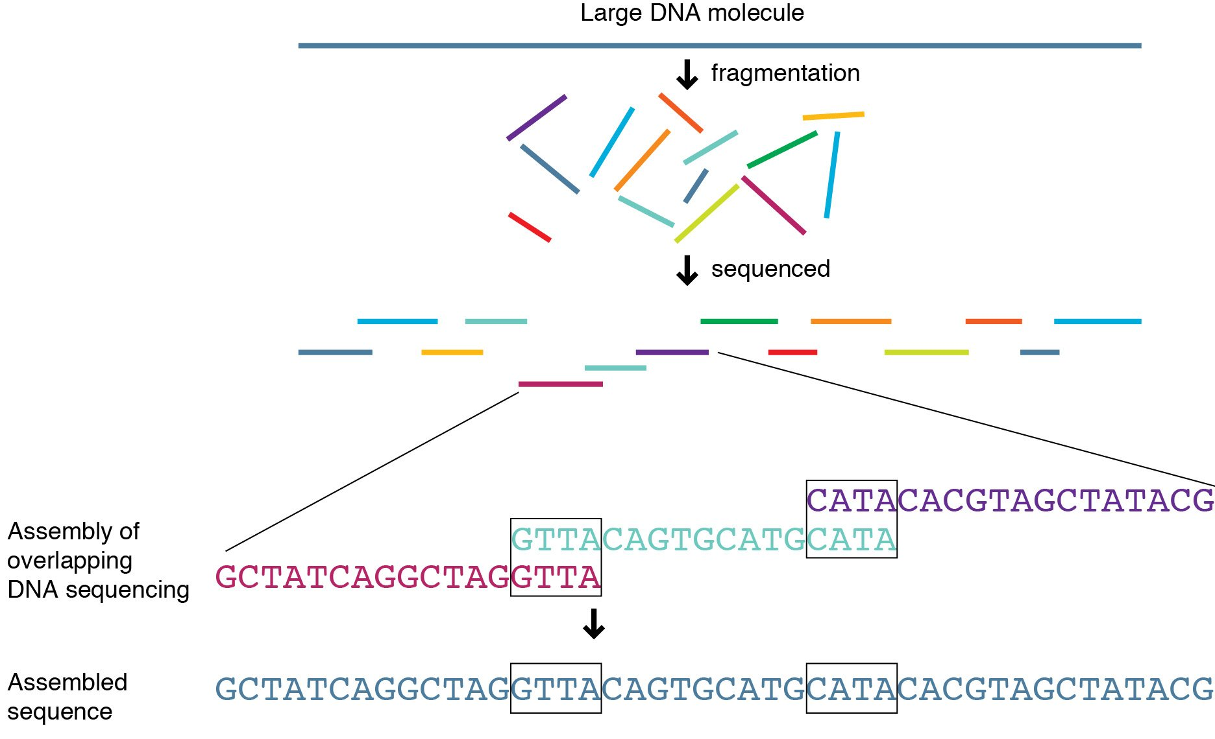
Shotgun Sequencing
http://knowgenetics.org

Slide 6
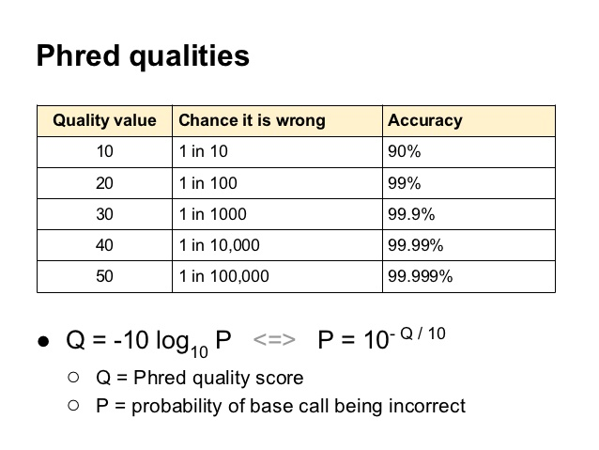
Greedy Assembly by Overlap
The first step in assembly is joining reads of overlapping sequence
This step must account for sequencing error rates
Sequencing software uses the PHRED score to measure error

Slide 7
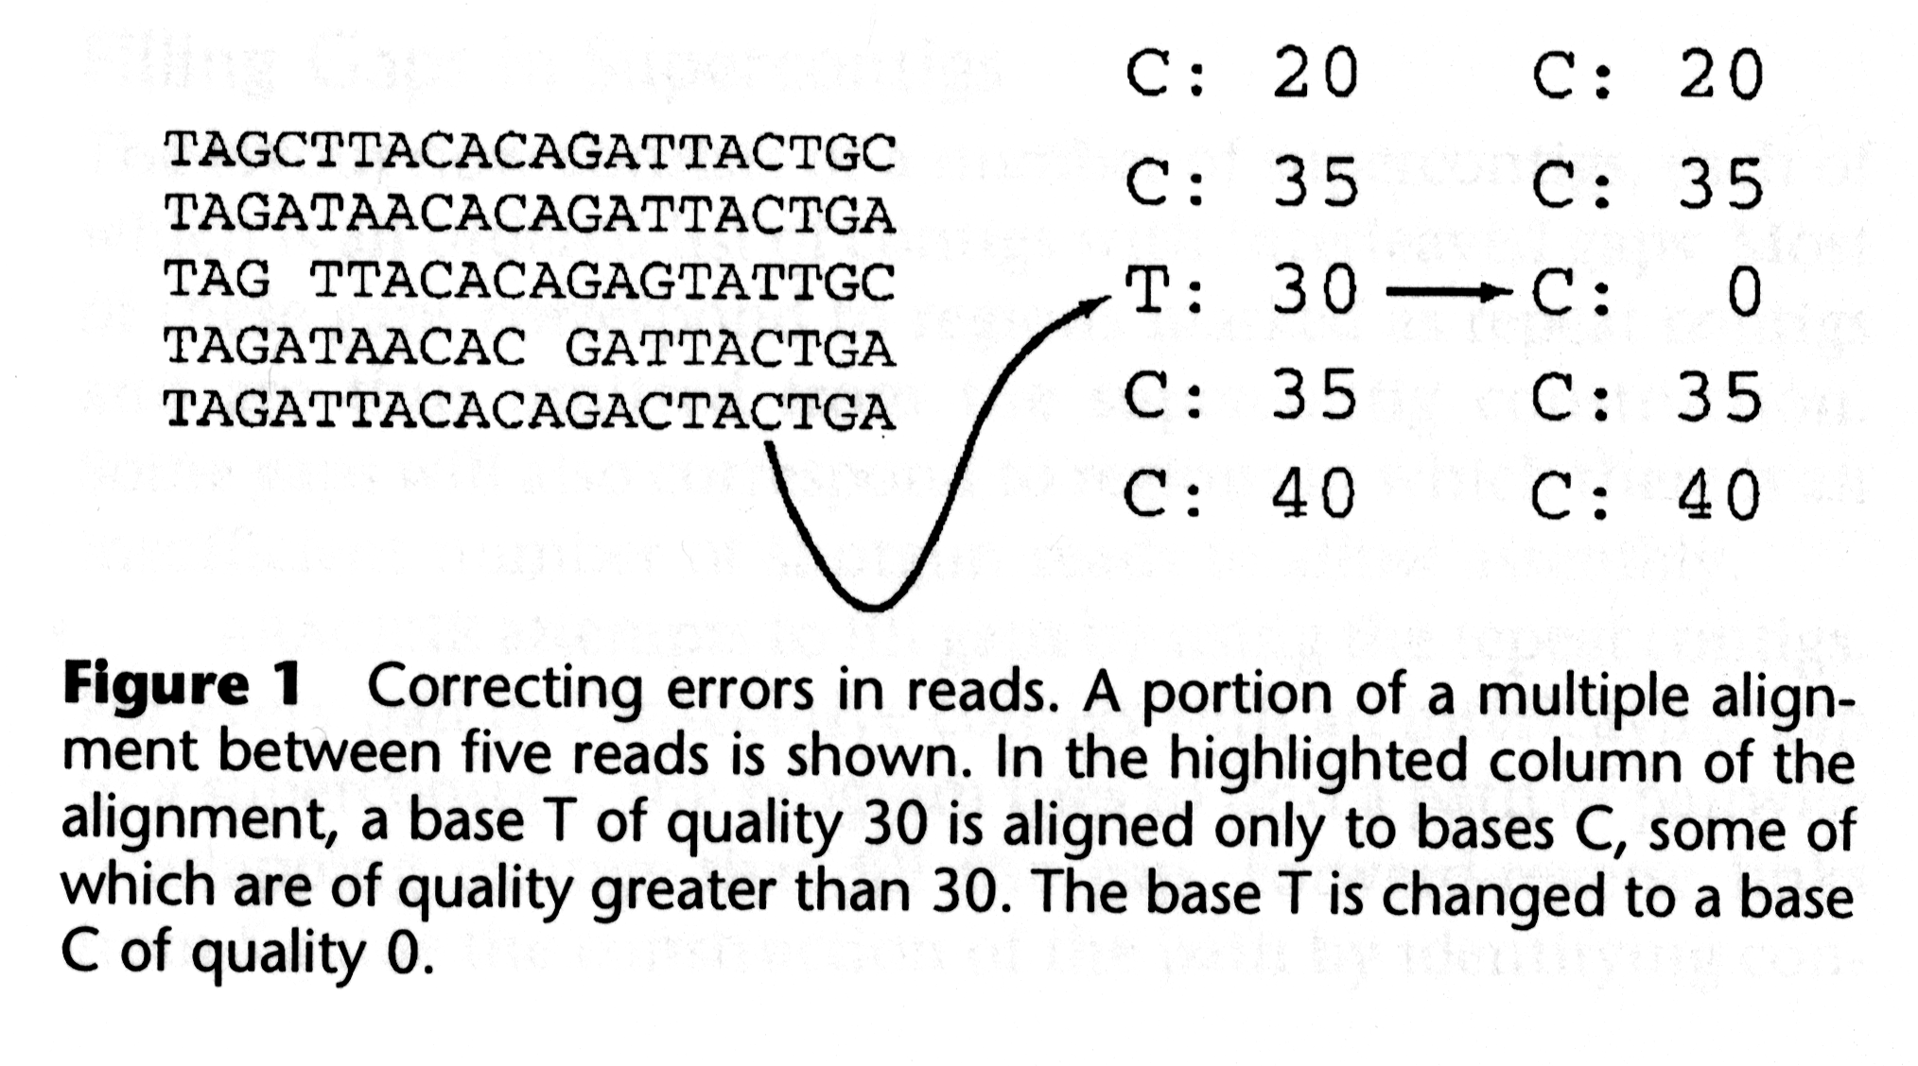
Greedy Assembly by Overlap
The first step in assembly is joining reads of overlapping sequence
This step must account for sequencing error rates
Sequencing software uses the PHRED score to measure error
Shotgun sequencing samples each region of the genome multiples times to generate a PHRED-correct consensus sequence
The depth of sampling of a genome is called ‘fold coverage’
the example above illustrates 5-fold coverage

Slide 8
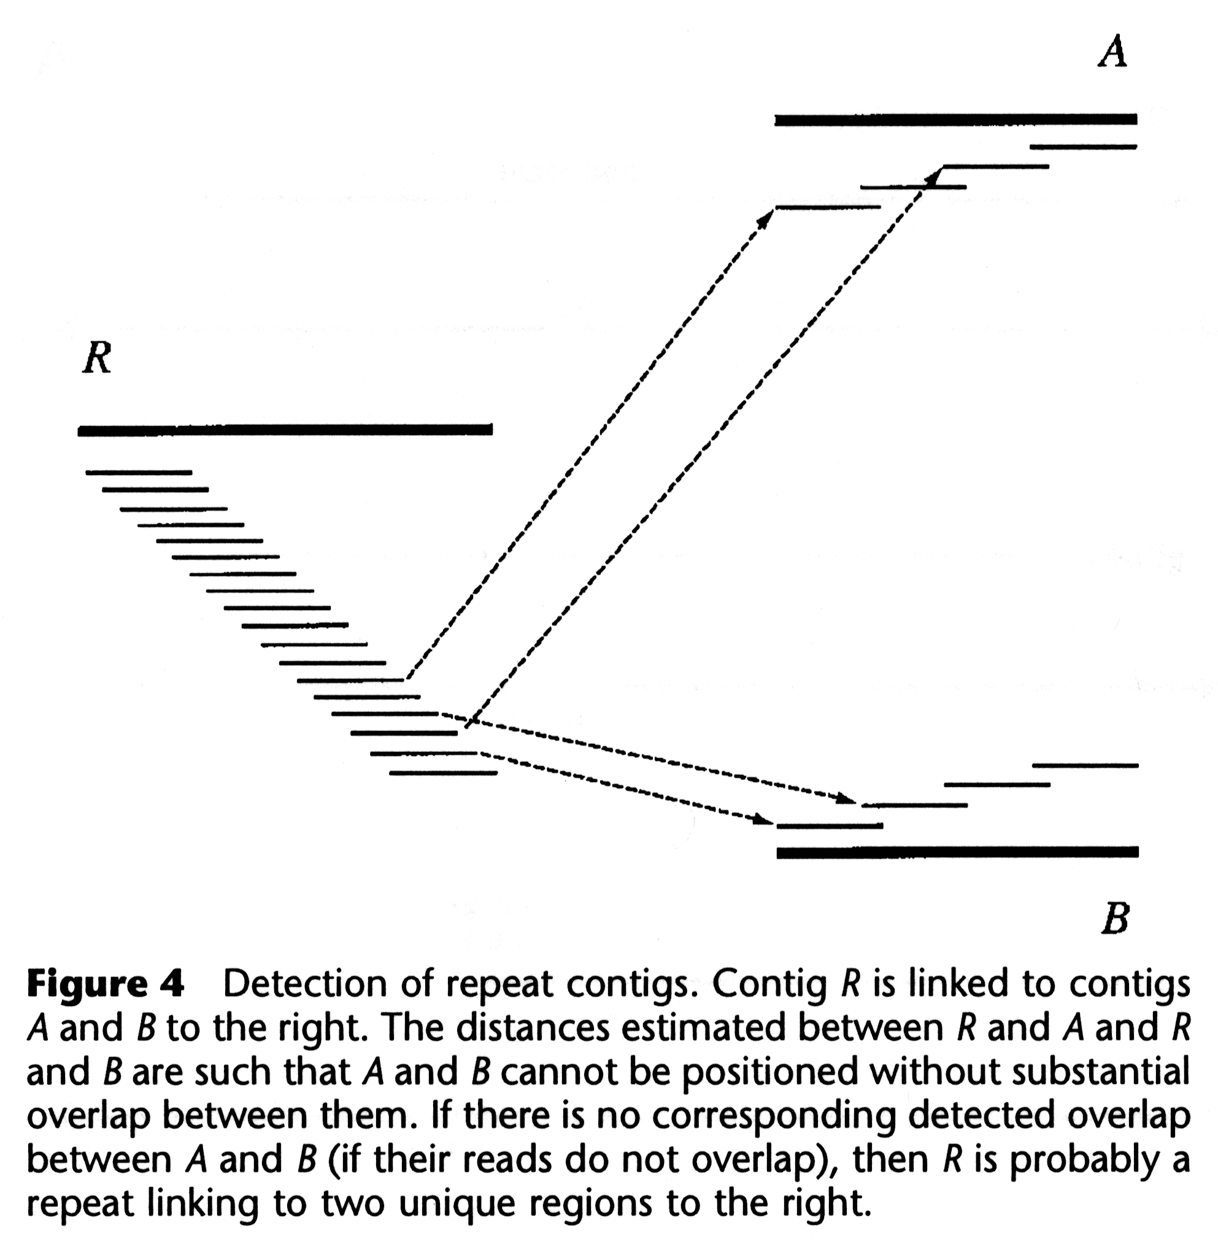
Repeats
Greedy algorithms merge reads into consensus ‘contig’ sequences
What if reads are similar but from different parts of the genome?
Greedy algorithms are insufficient to handle this problem

Slide 9
Bi-directional sequence (aka Mate Pairs)
A large part of assembly algorithms are focused on detecting and correcting for repeats
If we sequence each DNA fragment from both ends, we have paired reads with a specific geometry
Must point towards each other
Gap between them must reflect size of DNA fragments sequenced
This geometry places constraints on the assembly algorithm and can tease apart repeats
As long as one read is from a non-repeat region, it will constrain its mate-pair to assemble nearby in the genome

Slide 10
Bi-directional sequence (aka Mate Pairs)
A large part of assembly algorithms are focused on detecting and correcting for repeats
If we sequence each DNA fragment from both ends, we have paired reads with a specific geometry
Must point towards each other
Gap between them must reflect size of DNA fragments sequenced
This geometry places constraints on the assembly algorithm and can tease apart repeats
As long as one read is from a non-repeat region, it will constrain its mate-pair to assemble nearby in the genome
250 bp read
1500 bp fragment
250 bp read

Slide 11
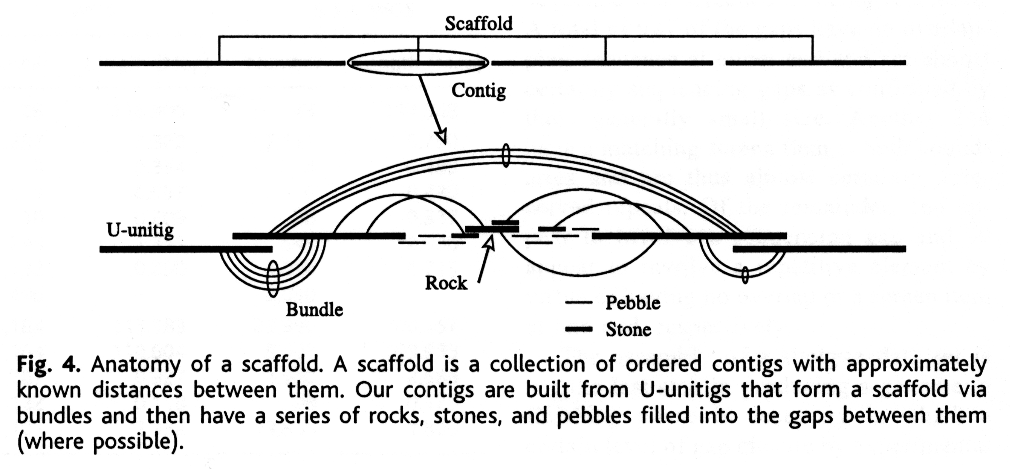
Bi-directional sequence (aka Mate Pairs)
Constraining greedy algorithms by using mate-pairs leads to contig sequences joined into scaffolds and separated by gaps
This combination is very effective for accurate genome assembly, except when both reads are in repeat regions:
Long regions of repeats
Highly repetitive genomes
High nucleotide bias

Slide 12


Slide 13
Then…
Pre-NGS used Sanger sequencing
Long reads (i.e. Li-COR 1200 bp) but very low volume
20-fold was considered good coverage
Each sampled DNA fragment had to be cloned into a plasmid or phage vector
Costly and labour intensive!
Plasmid library construction will not clone all sections of the genome (i.e. telomeres, centromeres)
Plasmid library construction suffers from sampling bias – unenven sampling of mate-pairs across the genome
Gel or capillary migration of DNA problematic for some regions of the genome, struggled with GC bias, and often confounded by DNA secondary structure
PHRED was a critical advance
Assembly software emphasized mate-pairs and used overlap-layout-consensus (OLC) ‘graph theory’ methods; long reads spanned repeat regions

Slide 14
Now…
NGS Genome Assembly
Currently dominated by Illumina short read technology
250 bp mate pairs but 100s-fold coverage
No cloning – DNA fragments ligated directly to sequencing adapters
No specialist cloning skills
Commercial genome sequencing kits
Considerably less sampling bias
Huge cost savings
Different sources of DNA sequencing error
PHRED scores adapted for NGS
High fold-coverage = high quality contig consensus sequences
Shorter reads less likely to span repeat regions
Repeats more problematic than long-read Sanger sequencing
Assembly software emphasizes k-mers, de Bruijn graphs, Eulerian paths
Modern pipelines include secondary ‘finishing’ or error-correction algorithms; optical mapping experiments can provide validation data

Slide 15
The A5 microbial genome assembly pipeline
Tritt et al. 2012. PLoS One. 7:e42304.

Slide 16
The A5 microbial genome assembly pipeline
PHRED trimming, error correction – only use high quality data in genomic pipelines!
Tritt et al. 2012. PLoS One. 7:e42304.

Slide 17
The A5 microbial genome assembly pipeline
Tritt et al. 2012. PLoS One. 7:e42304.

Slide 18
The A5 microbial genome assembly pipeline
k-mers, de Bruijn graphs, Eulerian paths, mate-pairs
Tritt et al. 2012. PLoS One. 7:e42304.

Slide 19
The A5 microbial genome assembly pipeline
library size estimation; bad mate-pair geometry
Tritt et al. 2012. PLoS One. 7:e42304.

Slide 20
A5QC / SSPACE ‘Finishing’
library size estimation; bad mate-pair geometry
Tritt et al. 2012. PLoS One. 7:e42304.

Slide 21
A5QC / SSPACE ‘Finishing’
library size estimation; bad mate-pair geometry
Tritt et al. 2012. PLoS One. 7:e42304.

Slide 22
A5QC / SSPACE ‘Finishing’
library size estimation; bad mate-pair geometry
Tritt et al. 2012. PLoS One. 7:e42304.

Slide 23
kmers, de Bruijn graphs, Eulerian paths
k-mers, de Bruijn graphs, Eulerian paths, mate-pairs
Tritt et al. 2012. PLoS One. 7:e42304.

Slide 25
kmers, de Bruijn graphs, Eulerian paths
There are a wide variety of k-mer assemblers (e.g. Velvet, A5, SPADES, etc.)
Some are generalist others are specialist (e.g. A5 is microbial)
The SPAdes assembler is considered the best microbial genome assembler – uses multiple k-mer sizes
You have seen k-mers before – BLAST word sizes
A k-mer frequency spectrum is generated for a specific k-mer size

Slide 26
kmers, de Bruijn graphs, Eulerian paths
Creation and use of k-mer indices is the most efficient method for handling the large volume of NGS data – less memory!

Slide 27
kmers, de Bruijn graphs, Eulerian paths
Creation and use of k-mer indices is the most efficient method for handling the large volume of NGS data – less memory!
A deBruijn graph is created from the k-mers of all reads
all k-mers must overlap adjoining k-mers in the genome by k-1
repeat!

Slide 28
kmers, de Bruijn graphs, Eulerian paths
Creation and use of k-mer indices is the most efficient method for handling the large volume of NGS data – less memory!
A deBruijn graph is created from the k-mers of all reads
all k-mers must overlap adjoining k-mers in the genome by k-1
A deBruijn graph can be used to efficiently find read overlap for forming contigs & resolving repeated sequences
graph theory – the optimal Eulerian path visits every edge exactly once
repeat regions produce over-abundant k-mers and have identifiable deBruijn graph properties

Slide 29
kmers, de Bruijn graphs, Eulerian paths
Sequencing error creates ‘novel’ k-mers and complicates the deBruijn graph – genome assembly is thus always preceded by an error trimming & correction step
The product of k-mer assembly is a robust set of contigs, but what k-mer size to use?
Shorter – less memory, more complex deBruijn graph, difficulty with small tandem repeats
Longer – more memory, simpler deBruijn graph, overcome small repeats, upper maximum due to sequencing gaps, error filtering critical

Slide 30
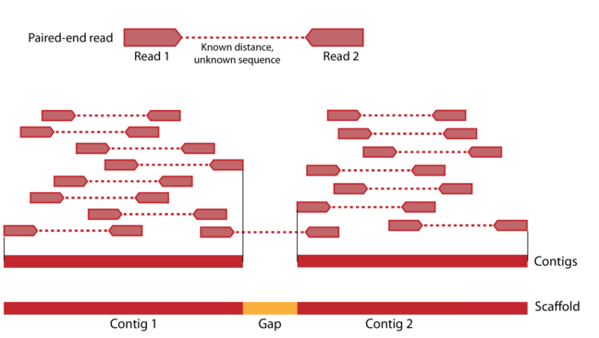
kmers, de Bruijn graphs, Eulerian paths
K-mer assembly produces ‘contigs’ – stretches of consensus sequences
More read coverage leads to denser deBruijn graphs, fewer & bigger contigs, less assembly gaps
Mate-pair information can then be used to determine scaffolds – the order of contigs along the genome
Scaffolding algorithms are greedy too – de Bruijn graphs (Velvet) or secondary algorithms (A5) seek to limit scaffolding errors

Slide 31
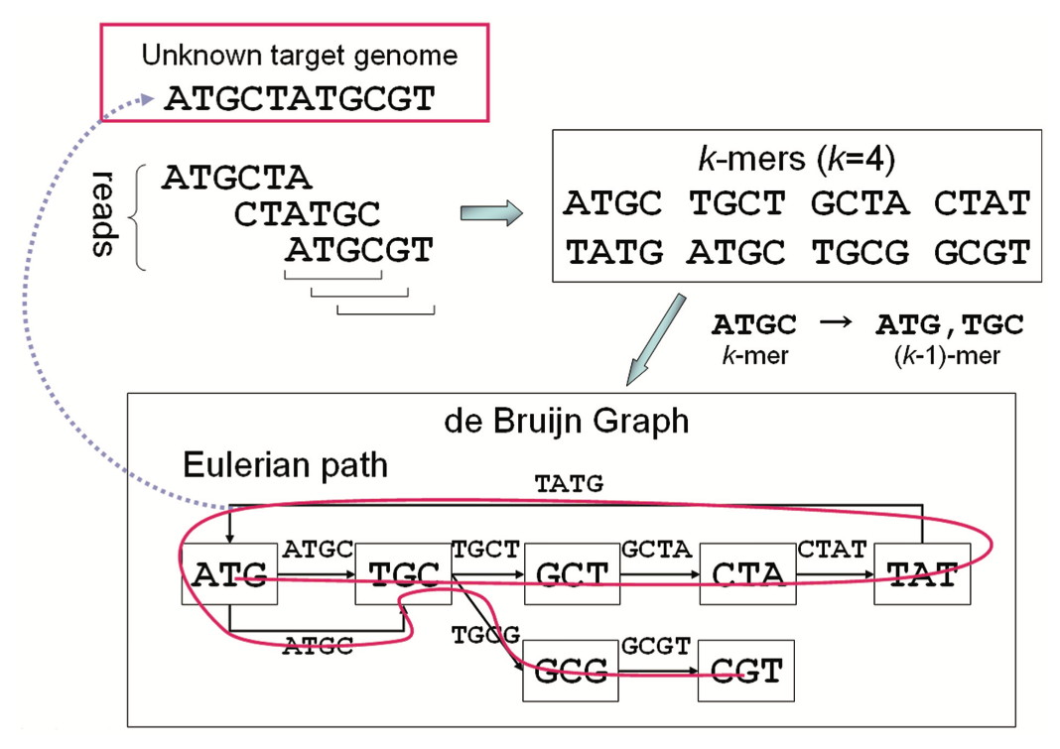
Try this example by hand…
Namiki et al. 2012. Nucleic Acids Research 40:e155

Slide 33
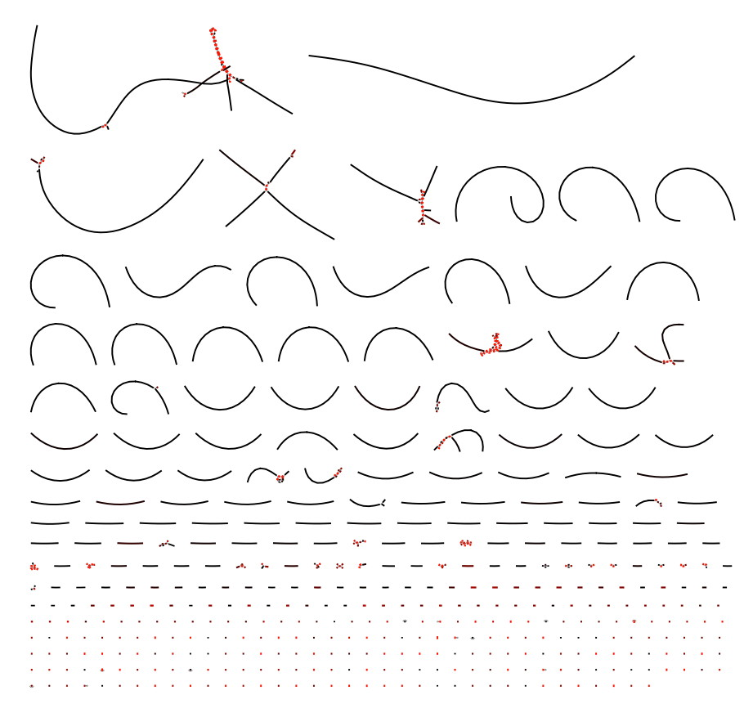
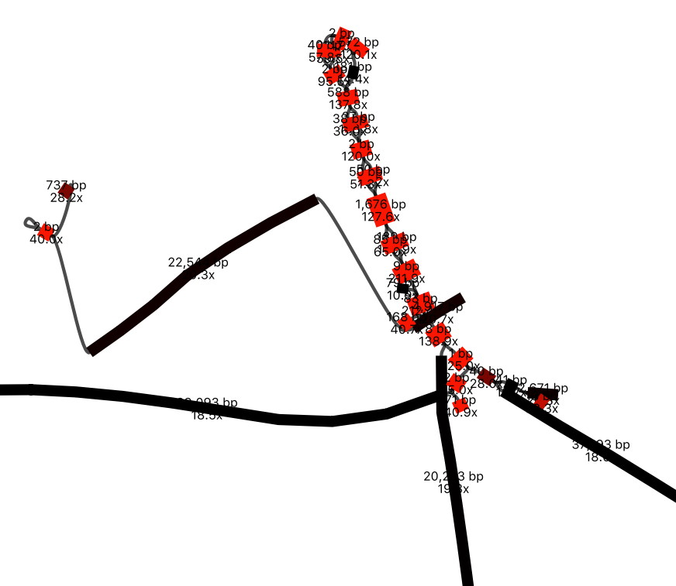
A complete assembly…
BANDAGE visualization

Slide 34
Assembly Statistics – A5 example
McMaster E. coli C008 strain with Illumina HiSeq 2 x 250 bp sequencing
Raw 3,735,008 sequencing reads totaling 933,752,000 bp
~200 fold coverage of the E. coli genome (E. coli K-12 is 4,639,221 bp)
3,666,906 error-corrected reads totaling 797,138,877 bp
98.18% of reads passed error-correction
85.03% of nucleotides passed error-correction
118 contigs in 118 scaffolds
5,247,627 bp sum contig length
bases ≥ Q40 = 5,243,991 (99.9% of assembly; Q40 = 1 in 10,000 error rate)
Longest scaffold = 534,047 bp
Contig N50 = 166,170 bp (at least 50% of the assembly is contained in contigs of this size or larger)
GC content = 50.6%
Observed read coverage = 178.65 fold
Median = 154 fold; 10th percentile = 97 fold
For a nice review of A5 statistics, see http://tinyurl.com/zwng5cb

Slide 35
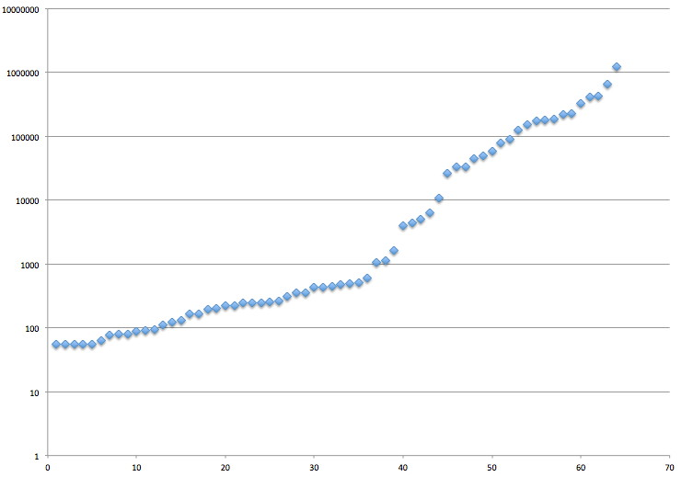
N50
N50 is the size of the contig which, along with all larger contigs, contains half of sequence of an assembly.
top contig = 1,223,670 bp
top 2 contigs sum = 1,871,154 bp
sum of all contigs = 4,740,890 bp
1/2 sum of all contigs = 2,370,445 bp
this is the N50 contig, with length 405,903 bp
top 3 contigs sum = 2,299,813 bp
top 4 contigs contain 1/2 of the assembly, sum = 2,705,716 bp
N50 = 405,903 bp
contig size (bp)
contigs ordered smallest to largest ->

Slide 36
Finishing, Validation, Confidence
‘Finishing’ traditionally refers to the costly and labourious steps required to ‘close’ all the sequencing gaps to provide high quality and 100% complete chromosome sequences (aka “closure”)
Finishing is workable for bacterial genomes but very hard for eukyarotic genomes
centromeres and teleomeres are hard to clone or sequence
yet important biology is encoded in these regions (e.g. Trypanosoma)
Most current genome projects do not attempt closure due to:
the cost and time involved – closure does not get funded
shotgun routinely obtains >90% closure and thus the majority of the biology
gaps will be closed by research teams if it is relevant to their science
‘Finishing’ now most often refers to the scaffolding quality control steps in genome assembly – making the most out of the shotgun data – and is seen as distinct from ‘closure’

Slide 37
Finishing, Validation, Confidence
Validation of genome assembly is difficult as our knowledge about the genome we are sequencing is often limited
If a closely related genome sequence is known, a comparison can be made to determine possible errors – or are they real differences?
Genome annotation can identify gaps in the assembly (e.g. missing genes known from PCR or biochemistry)
With limited prior knowledge, bioinformaticians rely on the assembly statistics such as Q40, N50, etc.
But can we trust the assembly software?
Peer-reviewed publication of algorithms and open source release of software
Head-to-head comparison of assemblers on the same data to identify consensus
Simulated data and Assemblathon / GAGE competitions

Slide 38
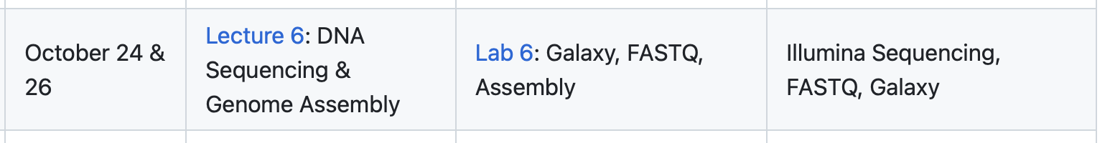
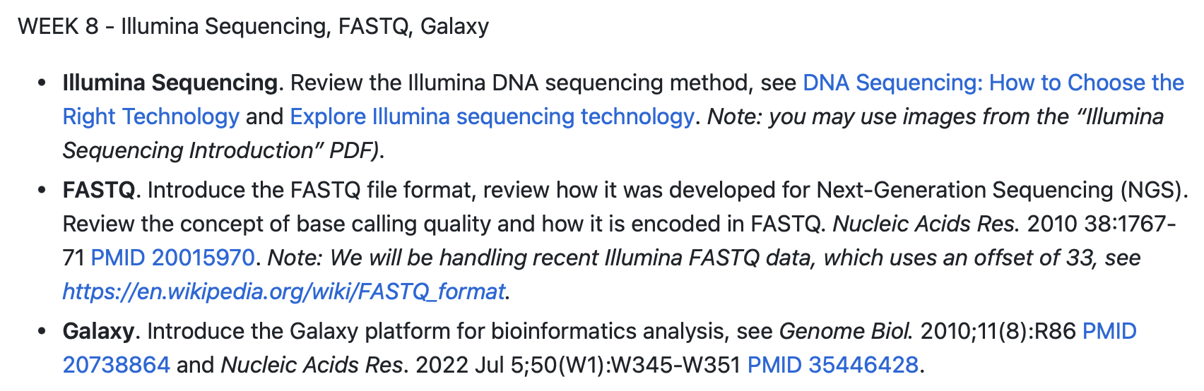
This week...

